Slide 2
Dr.Fawwad Ahmad
Associate Professor
Institute of Animal and Dairy Sciences
University of Agriculture, Faisalabad

Slide 3
Qualification
Degrees obtained | Name and Place of University and college | Year | Major Subjects
Ph.D. | University of Agriculture, Faisalabad. | 2004 | Poultry Husbandry
M.Sc.(Hons) | University of Agriculture, Faisalabad. | 1995 | Poultry Husbandry
B.Sc.(Hons) | University of Agriculture, Faisalabad. | 1993 | Animal Husbandry
Primary to Matric. | JLS/ LHS, University of Agriculture, Faisalabad | 1978-1988 | Science

Slide 4
Achievements
Awards and Shields
Gold Medals = 4 (UAF= 1, Industry= 1, Welfare= 2)
Shields and Trophies = 29 (Exhibitions, Conferences and Fancy Birds Shows)
Star laureate Award = 1 (Best Scientist of Year )

Slide 5
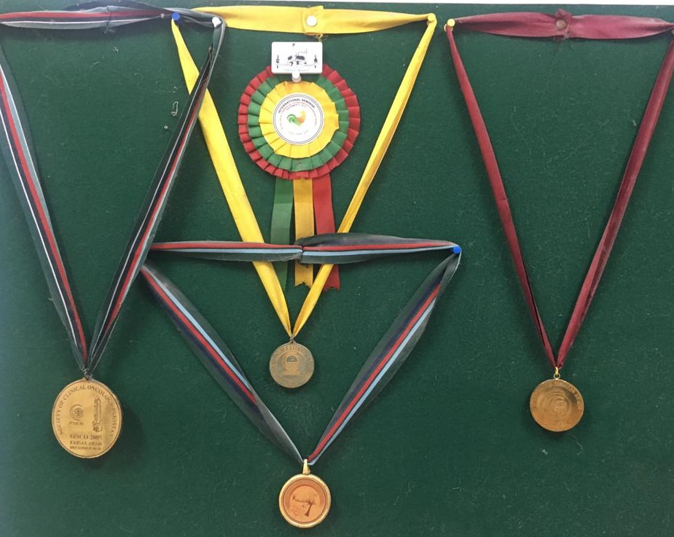

Slide 6
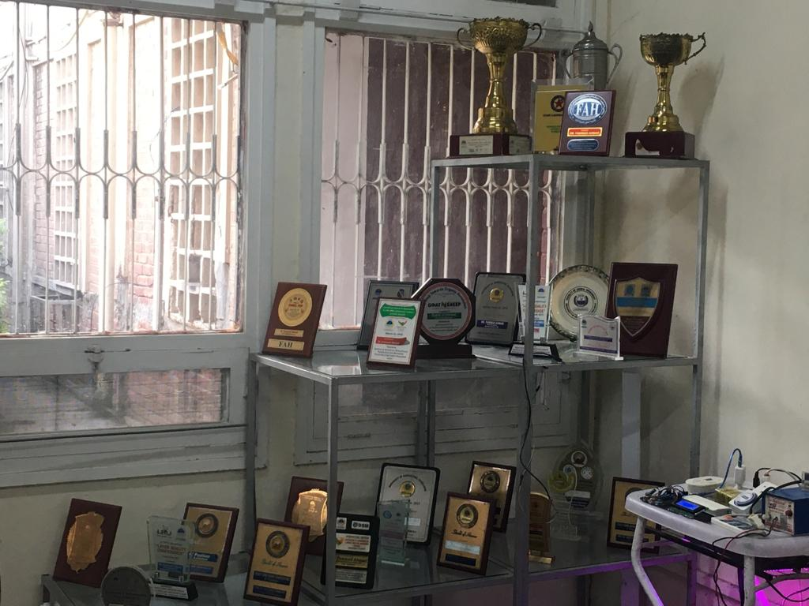

Slide 7
Achievements
Certificates of Participation: (Workshops, Trainings and Seminars) = 30
Certificates of Appreciation: (Exhibitions, Kissan Mela and Birds Shows) = 26
Represent AH Faculty in University Exhibitions a 1st Position Six times and Second Position two times as best Faculty Stall of the year for Technology Transfer.
Certificates of Sports Activities: = 03

Slide 8
Achievements
Development of Farm Visit Performa for Teaching and Research Activities as well as Industrial Linkage
Research Papers =52
(Feeding, Brooding, Lighting )
Books =4
(Birds and Animals in Quran, Feeding Management, Farm Management , Environment Controlled Housing and Fancy Birds Production )
Book Chapters = 2
(Housing, Bio-security)
Manuals /Reports = 3
(Farmer Friendly Technologies, Model Village Development)

Slide 9
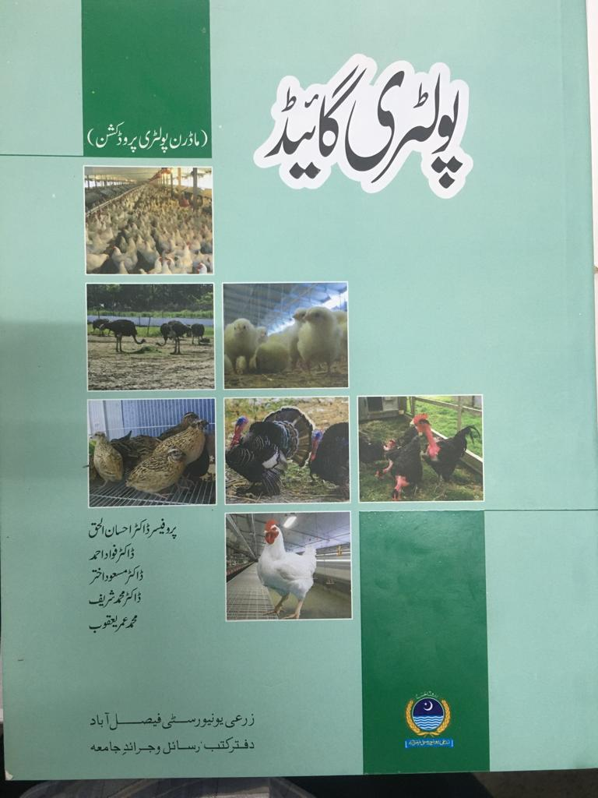
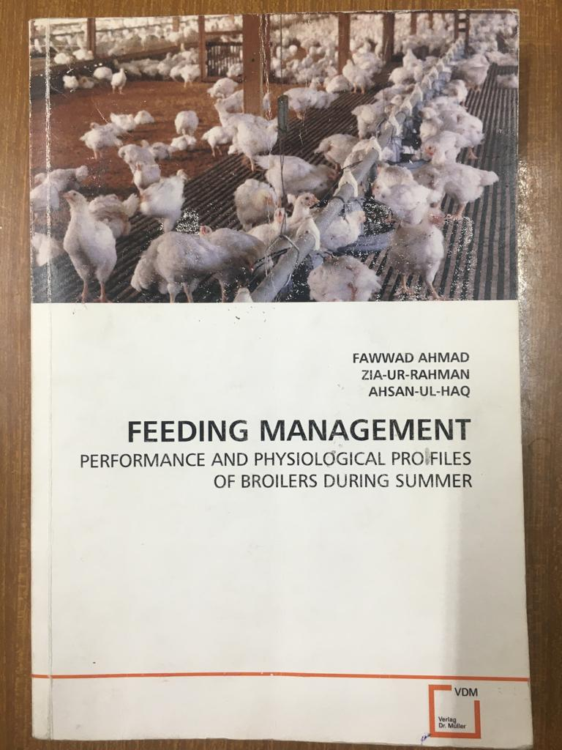
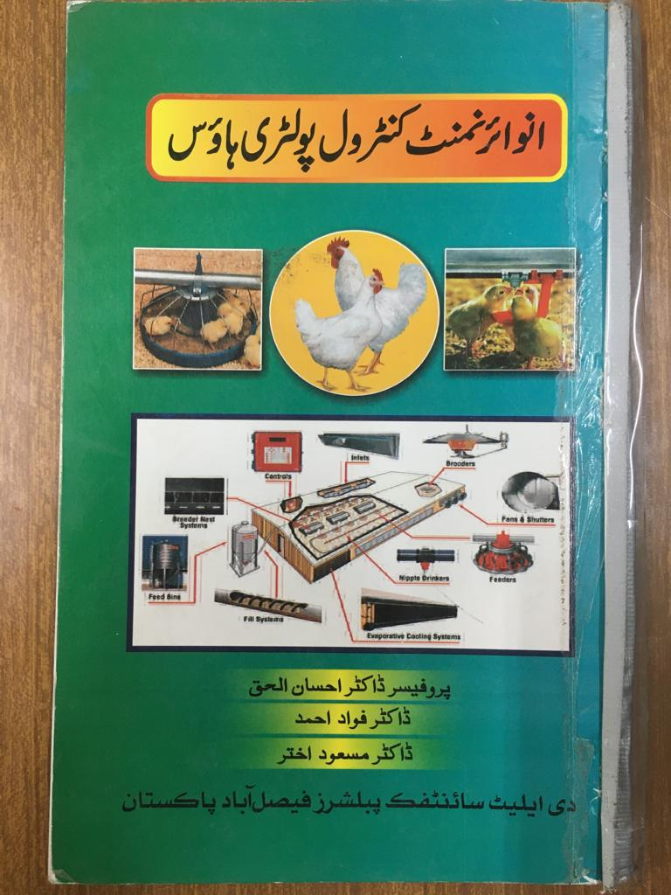
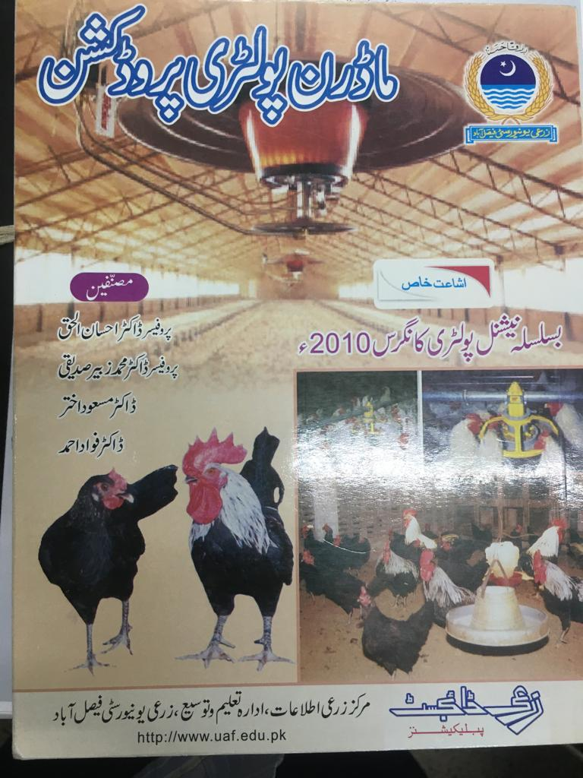
Books

Slide 10
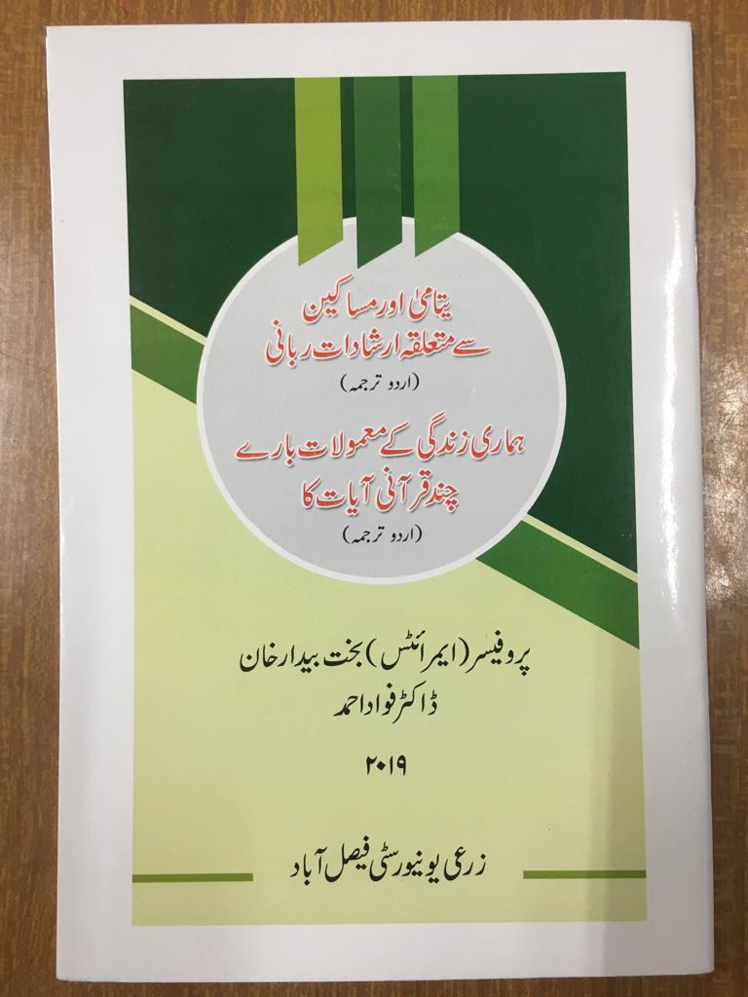
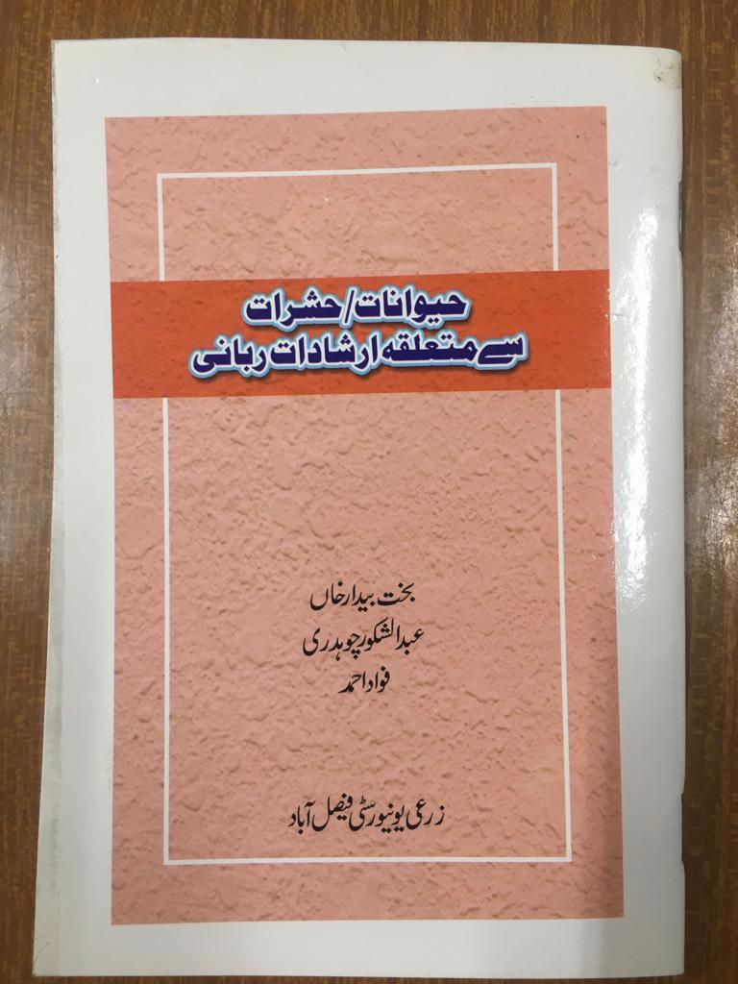
Books

Slide 11
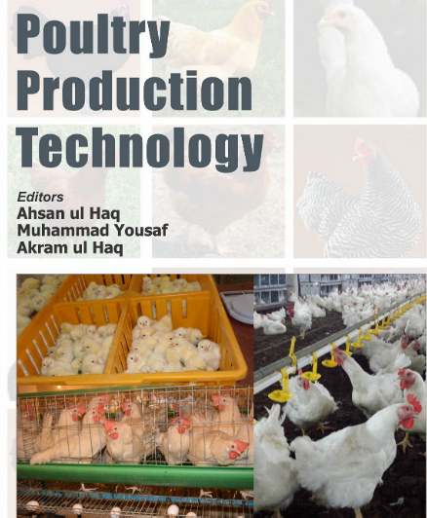
Book Chapters

Slide 12
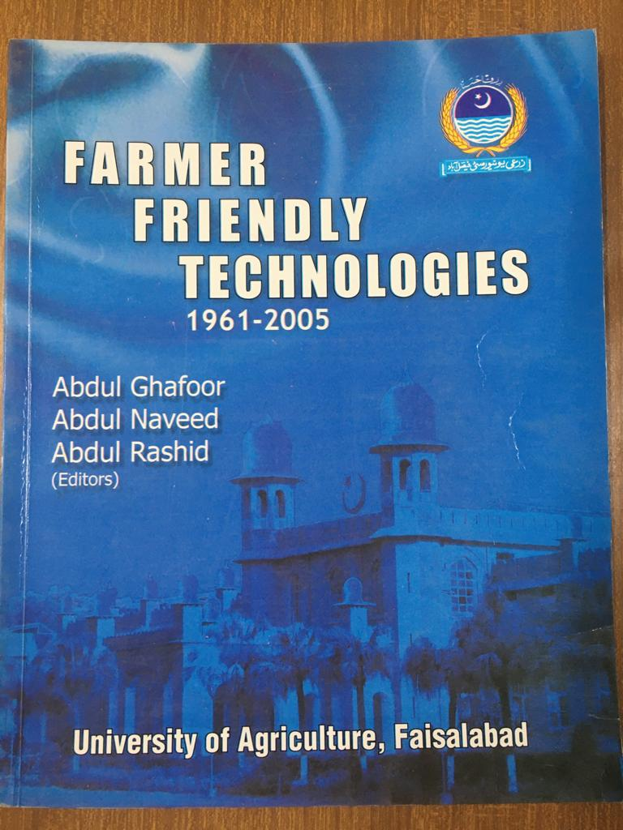
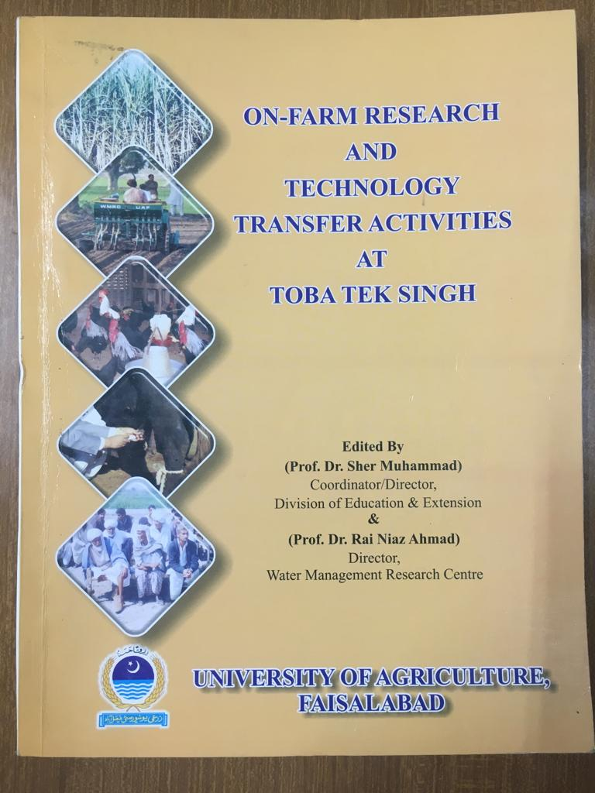
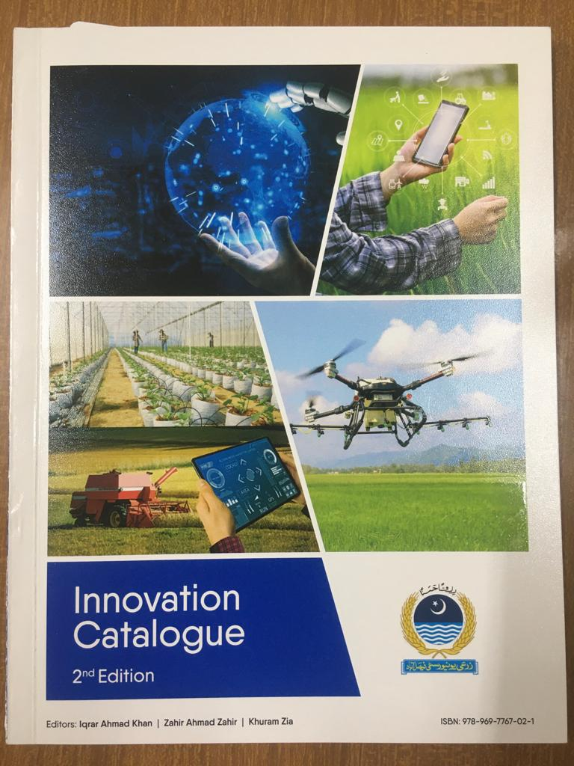
Manuals and Reports

Slide 13
Achievements
Abstracts = 13
(Feeding, Brooding, Lighting)
Popular Articles = 34
(Poultry Farm Management, Fancy Birds Production)
TV/ Radio Programs = 11
( Poultry Business, Farm management, Feeding Strategies)
Welfare Projects = 07
(Cancer Patient Treatment, School, Diagnostic Laboratory, Ambulance Services, Free Medical Center, Faisalabad Development Trust welfare projects and UAF students welfare as Flood Relief Funds for students Fee)

Slide 14
Welfare Project 1: Fee Arrangement for Flood Affected Students of UAF

Slide 15
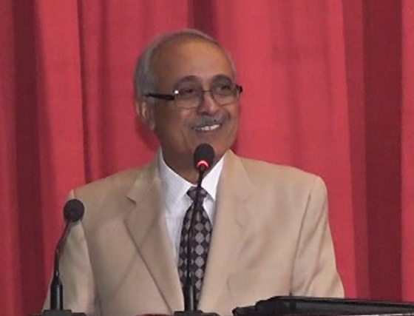
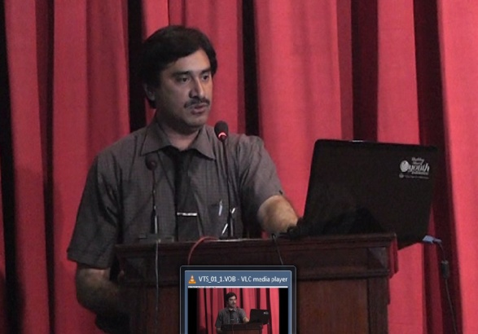
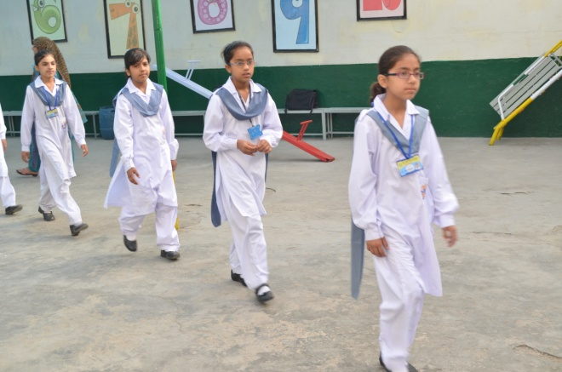
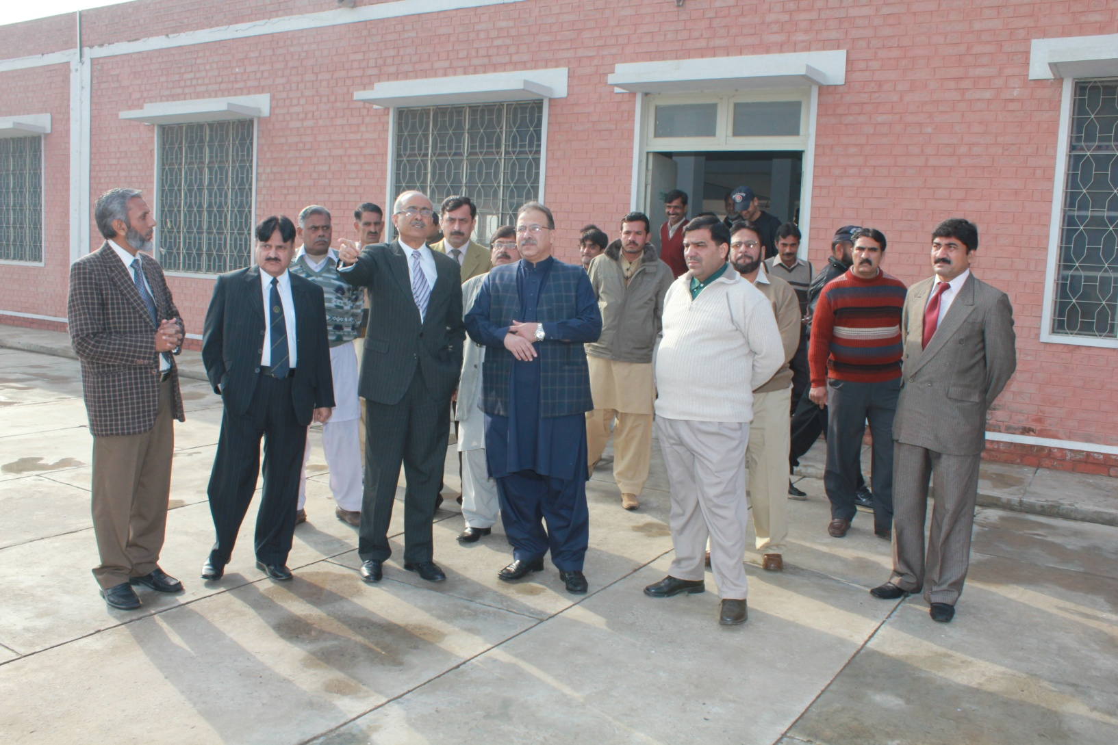
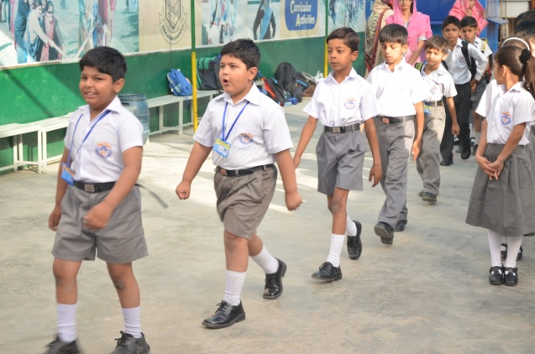
Welfare Project 2: School and College Startup Fee for UAF School Kids , Re-Start Agriculture Courses in Schools and FSc. Pre-Agriculture in Colleges working under my Consultancy

Slide 16
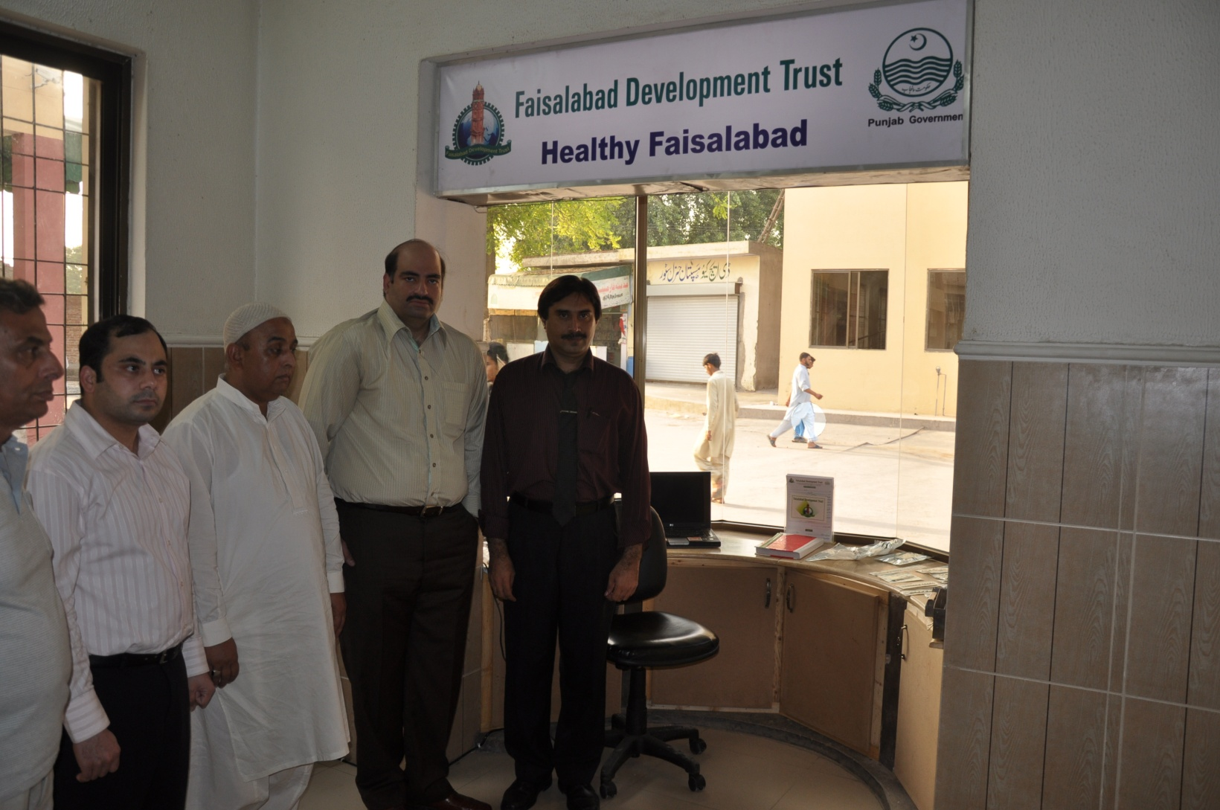
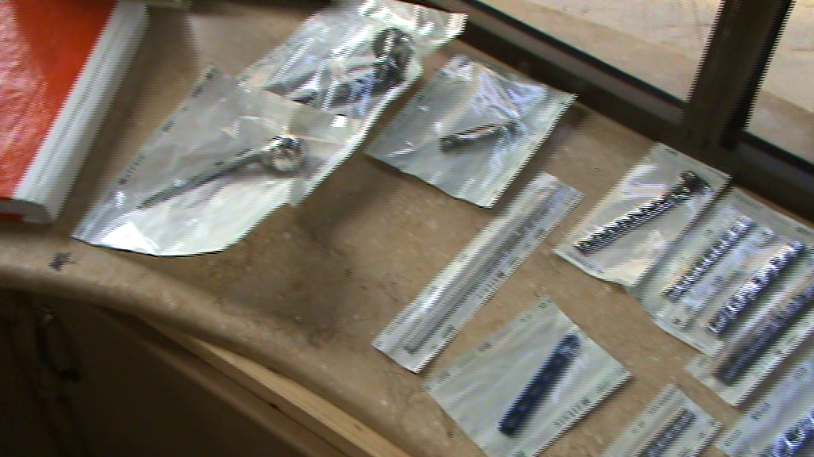
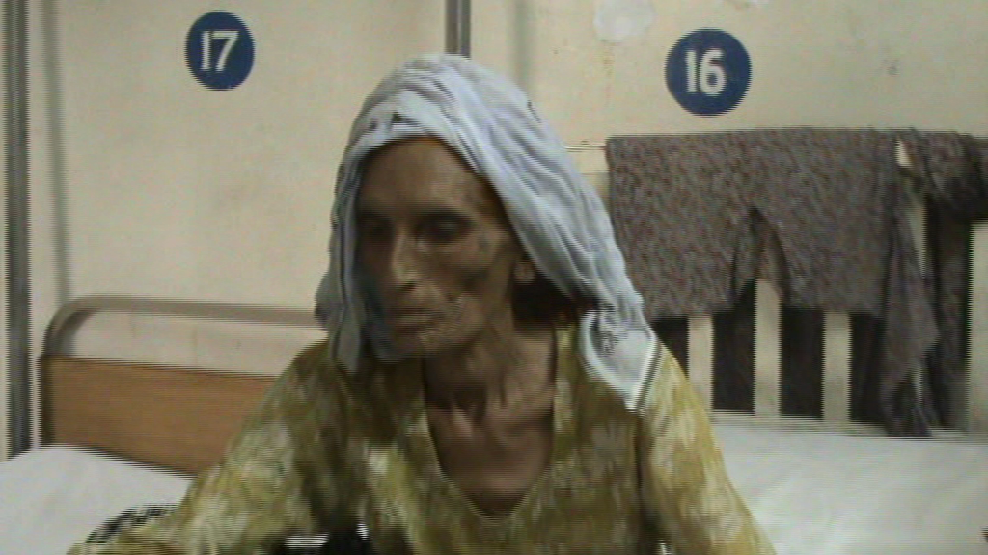
Welfare Project 3: FDT Cancer and Ortho Patients

Slide 17
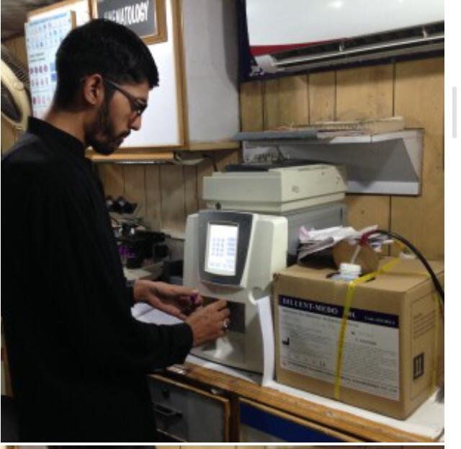
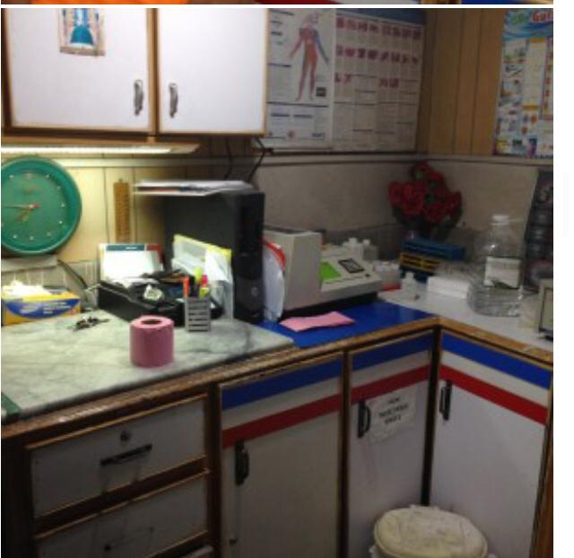
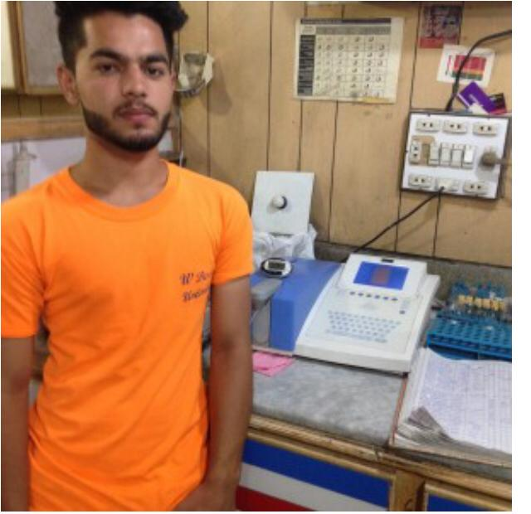
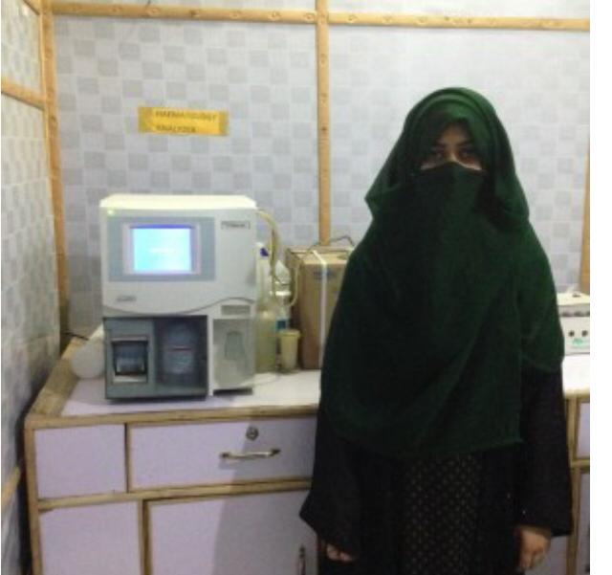
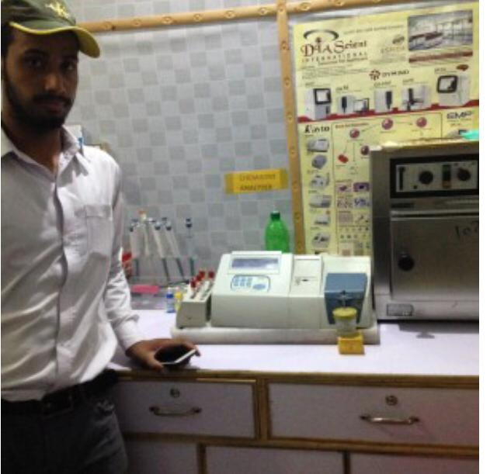
Welfare Project 4 Test Lab

Slide 18
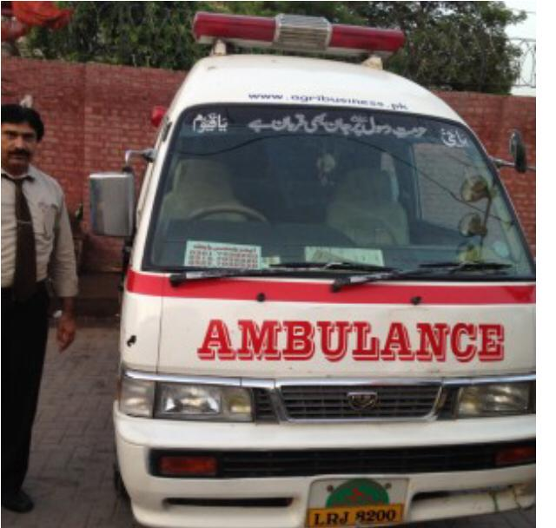
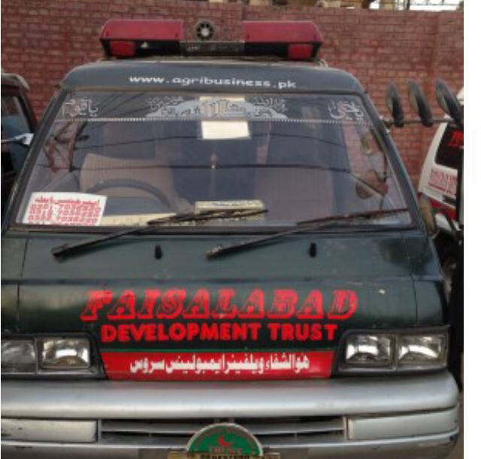
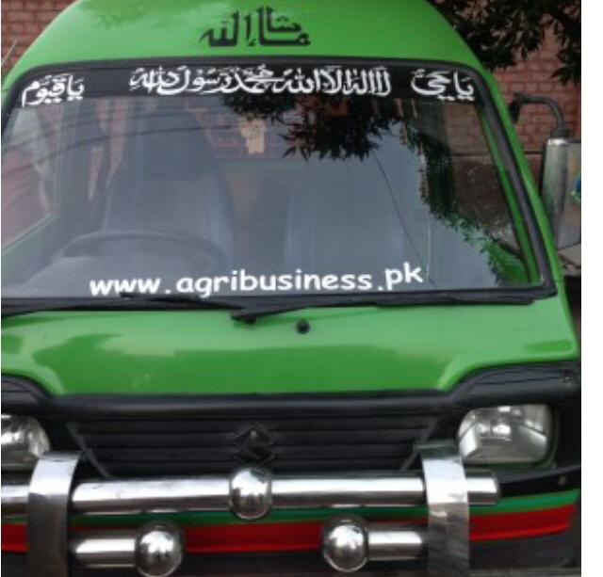
Welfare Project 5 Ambulance Survive

Slide 19
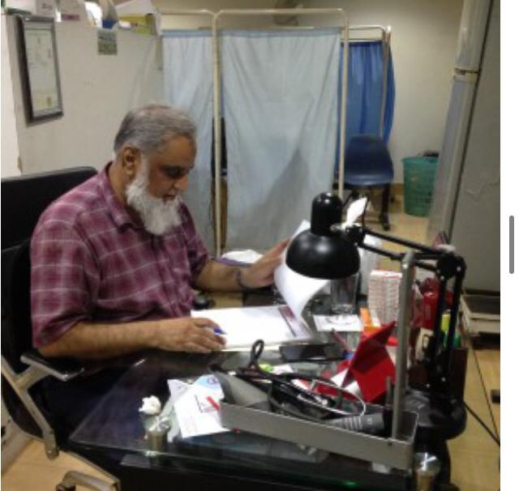
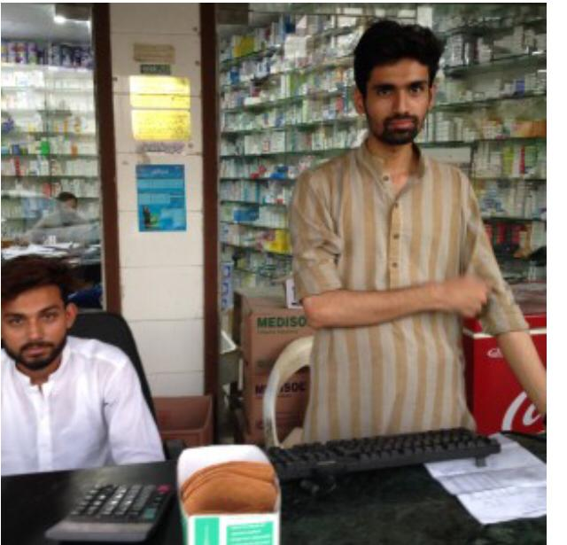
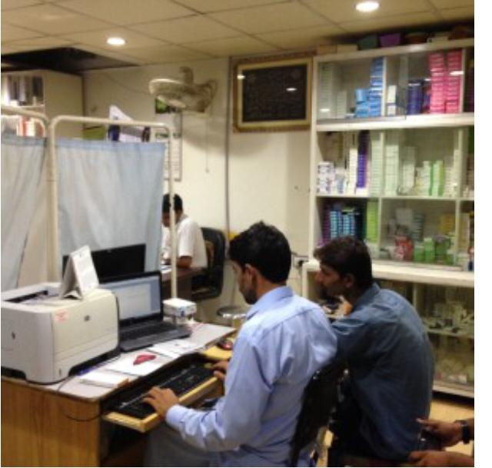
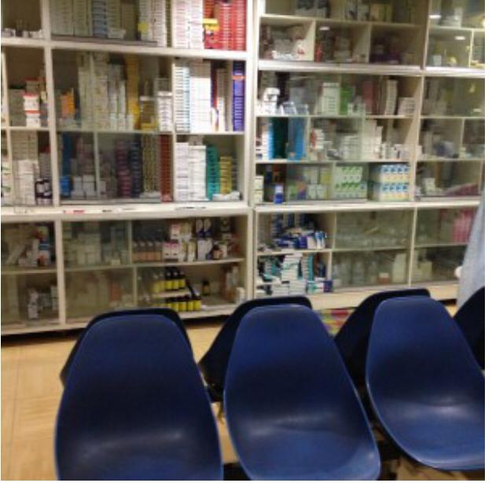
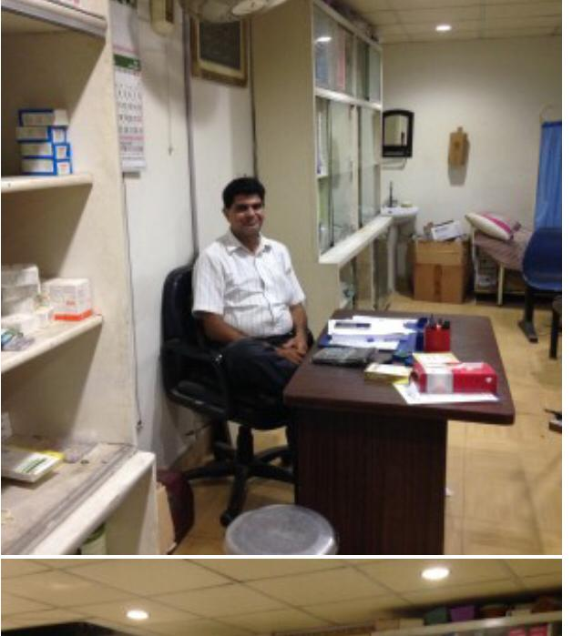
Welfare Project 6 Free Medicare Center

Slide 20
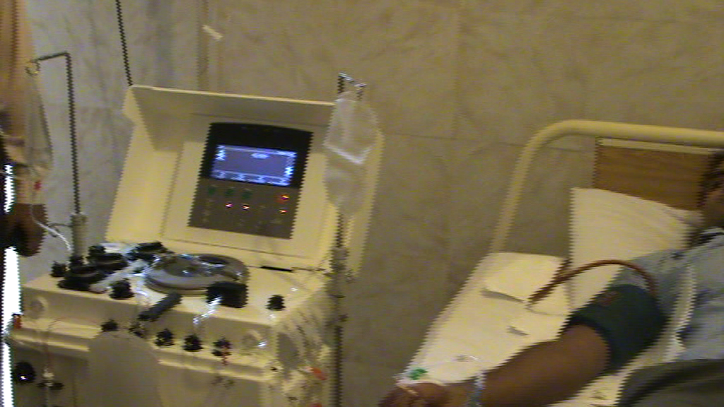
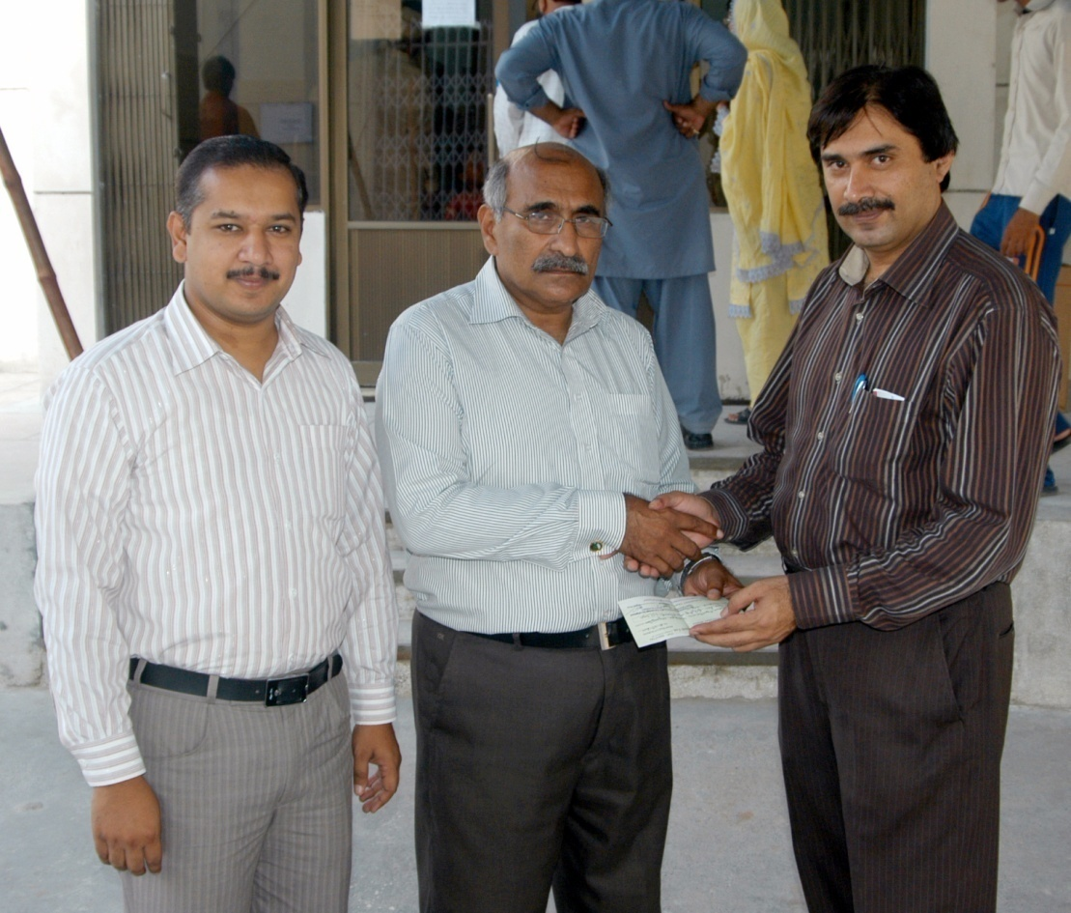
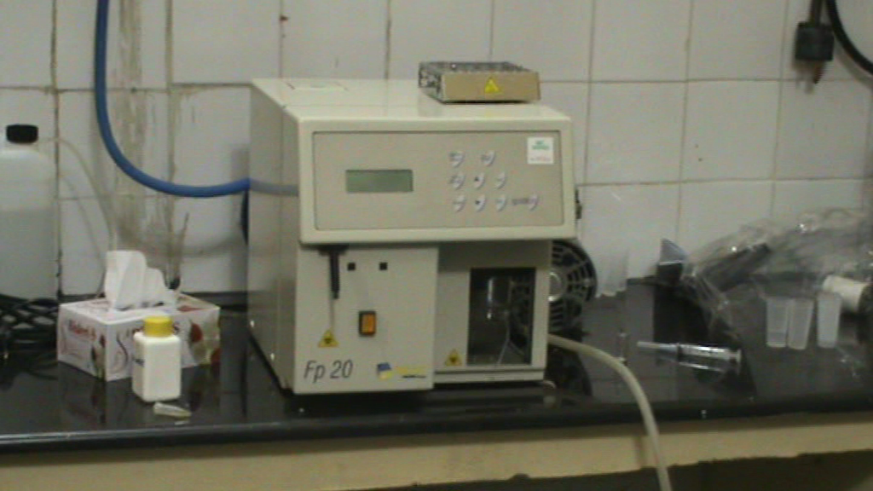
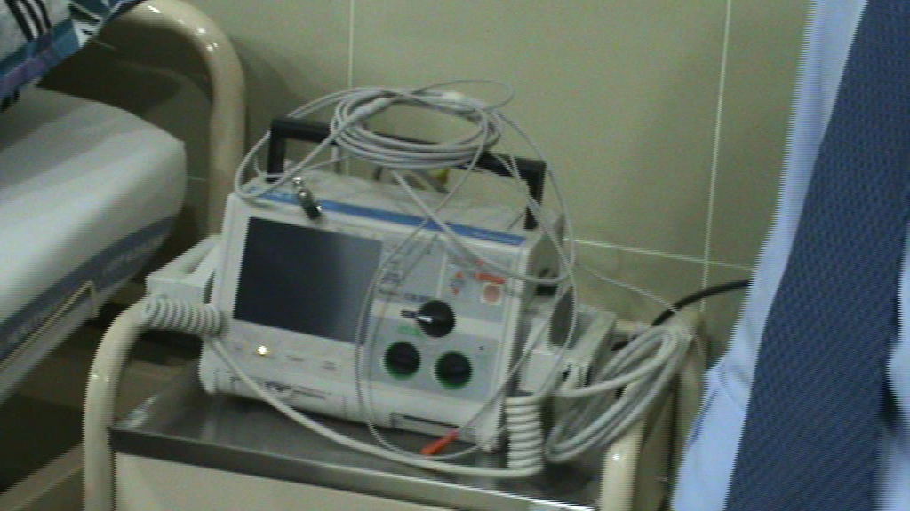
Welfare Project 7: Hospitals Up gradation ( AC, Defibrillators and Micro-lab FP-20)

Slide 21
Achievements
Development of website (www.agribusiness.pk) = 1
for (Interaction of Industry , Academia , Farmer and Students Linkage)
U Tube Educational Channel = 1
Development of Watsup Working Group for Marketing, Business Monitoring and Geo-Fencing = 5
Backyard Poultry = 1
Semi-commercial Poultry = 1
Commercial Poultry = 1
Integrated Sugarcane Farming for Sugarcane and Cotton = 2

Slide 22
Achievements
Student Supervised | M.Sc. (Hons.) / M.Phil | Ph.D.
As major Supervisor | 19 | 1
As committee Member | 54 | 2

Slide 23
Multidisciplinary Research
Sr. No. | Department | Degree/ Project | No Of Students Guided | Research Theme
1 | Animal Nutrition | M.Sc.(Hons) Animal Nutrition | 34 | Poultry Nutrition
2 | Computer Science, | M.Sc. Computer Science | 3 | Climate Controlling Software and Hardware
3 | Zoology | M.Sc. Zoology, | 4 | Nutrition of Fancy Birds Welfare of fancy Birds
4 | Agronomy | M.Sc. | 1 | Microenvironment Control and Plant’s Physiology
5 | Physics | M.Sc.Physics Ph.D. Physics | 2 | -Ultrasonic Rodent repellent -Light Management in Broiler and Biochemical Changes in Birds
6 | Physiology and Pharmacology | M.Sc. Physiology and Pharmacology | 3 | -Heat Stress in Layer -Heat Stress in Broiler -Light Management for Molted Hens
7 | Water Management | Project | 1 | Saline Water Treatment

Slide 24
Advisory Services to Poultry and Livestock Equipment Manufacturing Companies
 | Company Name | Products Consulted
1 | PAMICO Technologies | Temperature Humidity and Light Controllers, Small Incubators, Control panels for Feeding and Brooding systems.
2 | Zeenat Corporation | Gas brooder, Diesel Brooder, Radiant Brooder, Drinking System, Wench System for Curtains and Feeders, Ventilation Controllers. Cage System for Layer Birds
3 | Diam Engineering | Digital Coal Brooding System Cage System for Broilers and Layers
4 | Sabir Ice Wind Plants | Ventilation System for Environment Control Poultry Houses
5 | Avian Co. and Sultan Incubator Company | Incubators for Fancy Birds
6 | Ghazi Agropolive Industries | Citrus Pulp Draying Unit.
7 | SMT Group of Industries | Air purification system for prevention of corona virus.

Slide 25
Research Facilities Developed at UAF
Lighting System for Growth Chamber ( Agronomy )
Lighting System for Growth Chamber (Botany)
Environment Controlled Research Room No. 1 (AN)
Environment Controlled Research Room No. 2 (AN)
Environment Controlled Research Room No. 3 (AN)
Remodeling of Environment Controlled House (PRC)

Slide 26
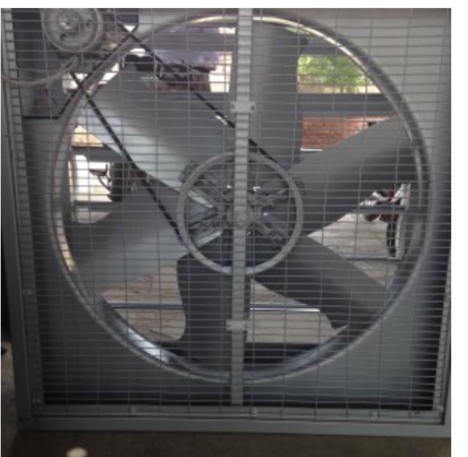
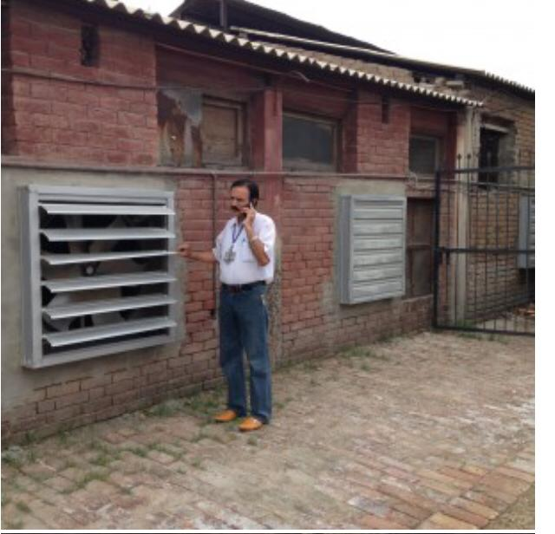
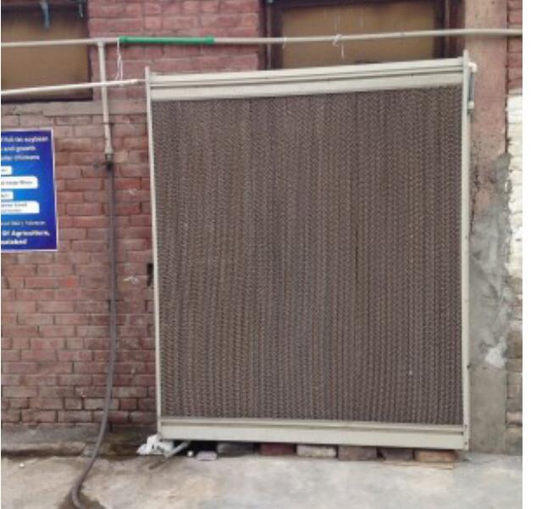
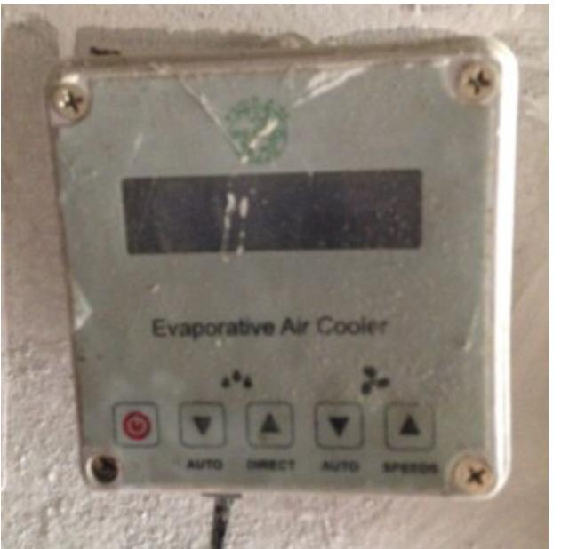
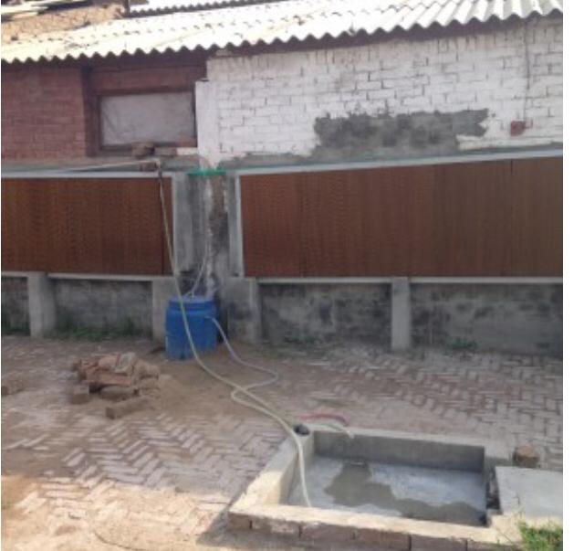
Pictures of ECH at AN

Slide 27
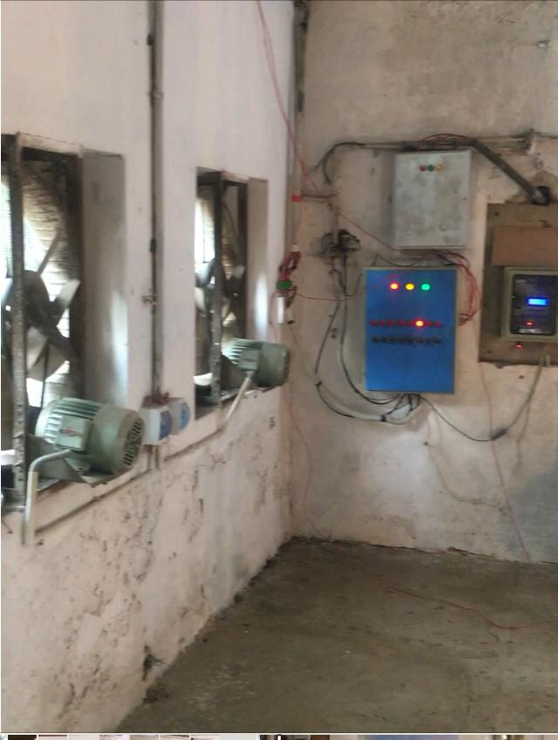
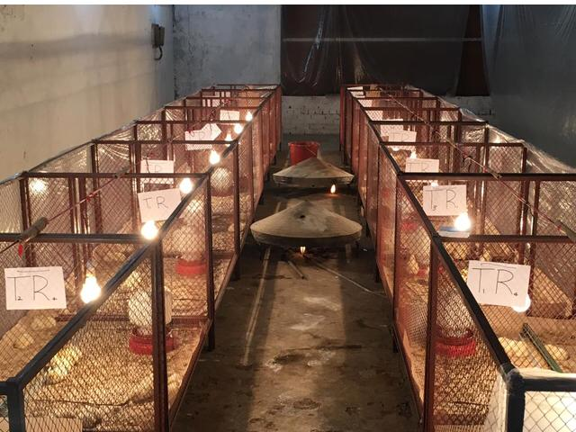
Pictures of ECH at PRC

Slide 28
Research, Projects and Equipment Development
PhD. Project ( Industrial Linkage )
Automatic Feeding System (Research Scale)
Automatic Water System
Automatic Lighting System
Farmer Friendly Equipment Project (EFS)
Automatic Feeding System (Commercial Scale)
Gas Brooding System
Integrated Farming System Project (EFS)
ECH Layer House
ECH Broiler House
ECH Climate Controller
Multi Fuels Brooding System
Layer Cage System

Slide 29
Research, Projects and Equipment Development
4. Citrus Pulp Treatment Project (HEC)
Citrus Pulp Drying System
5. Hydroponic Fodder Production Project ( Industrial Linkage )
a. Hydroponic Fodder Production System is Under Process.

Slide 30
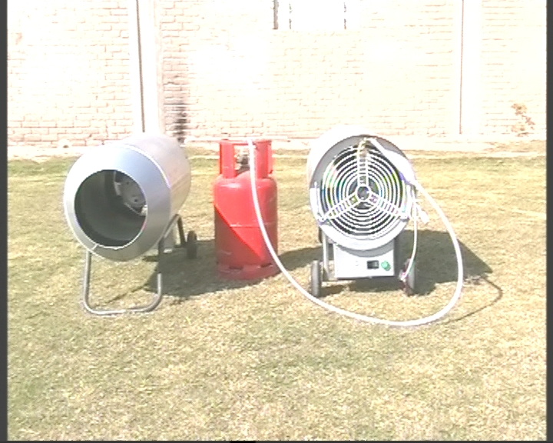
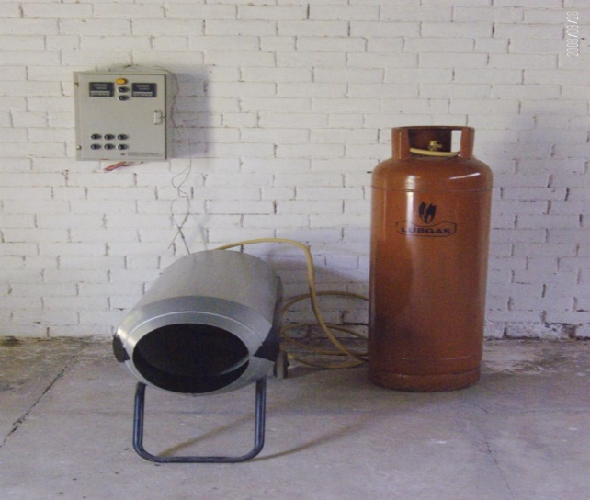
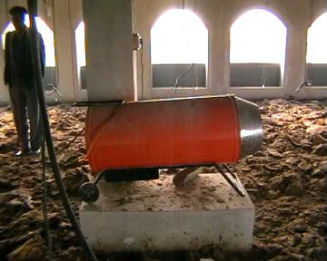
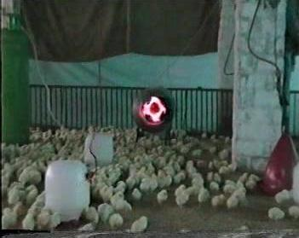
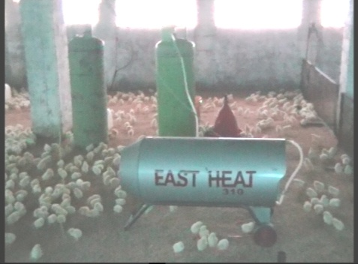
Farmer Friendly Equipments Project (Gas Brooding System, Gas Brooders Manufacturing Factory Development and Farmers Adaptation Jarawalla, Shahkoat Bipass.)

Slide 31
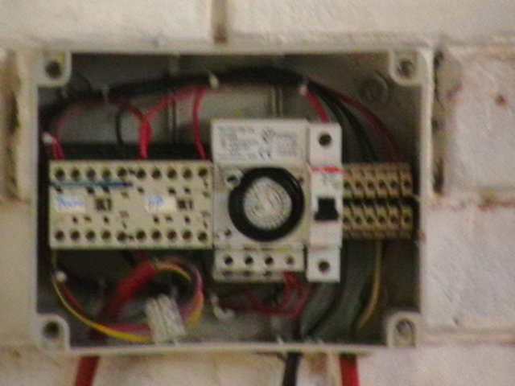
Farmer Friendly Equipments Project Wench System and Farmer Adaptation Jarranwalla

Slide 32
Small Scale ECH Remodeling at PRC and Farmer Adaptation Jirrawalla and Sunmmendri.

Slide 33
Climate Controller Development at UAF, Controller Manufacturing Factory Development and Farmers Adaptation Jarranwalla and Summandri

Slide 34
Layer Cage System Developed at UAF, Cage Manufacturing Factory development and Farmers Adaptation Shakupura , Summendri

Slide 35
Coal Brooding System, Coal Brooder Manufacturing Factory Development and Farmers Adaptation Jhang Road, Shahkoot.

Slide 36
Citrus Pulp Drying Project

Slide 37
Citrus Pulp Drying Project

Slide 38
Citrus Pulp Drying Project

Slide 39
Hydroponics Project

Slide 40
Hydroponic Project

Slide 41
Hydroponic Project

Slide 42
Hydroponic Project for Poultry Feed

Slide 43
Hydroponic Project

Slide 44
Consultancy Project Incubator Development, Incubator Manufacturing Factory Development for Fancy Bird Production

Slide 45
Consultancy Project Integrated Soft- wares of Poultry Livestock and Agriculture

Slide 46
Consultancy Project Corona Virus Air Filtration System and Cold Plasma Bio-security System

Slide 48
Project Fancy Birds

Slide 49
Project Fancy Birds

Slide 50
Exhibitions and Kissan Malas

Slide 51
Addressing three Important Component of Poultry Sectors
A. Rural Poultry or Backyard Poultry supported by Fancy Birds Production along with IT marketing system and small scale climate controlling systems and it’s Spread all Over the Pakistan.
B. Semi Commercial Poultry is Equipped with Farmer Friendly Equipments and Small Scale Environment Controlled Poultry Houses.
C. Commercial poultry is Supported by Highly Qualified Human Resource Specially Trained in ECH Controller Hardware and Software along with Farm Management Practices.

Slide 52
Future Plans
Feeding Strategies of Poultry Birds Under Climate Controlled Housing Systems.
2. Lighting Strategies of Poultry Birds kept Under Climate Controlled Houses.
3. Solar Energy based Brooding System for Poultry Birds
4. Hydroponic Fodder System for Land Conservation and Fodder Solution for high Yielding livestock as well as potential Feed Source for Organic Poultry Production.
5. Recycling of electric energy used in ventilation system.

Slide 53
Thanks UAF

